Slide 1
C# Training program

Slide 2
What is .NET?
Technology for building Enterprise Applications.
Its Platform Independent.
Used by multiple languages.
C# (C-Sharp) is the prominent language of .NET Environment.

Slide 3
What is C#?
New Language targeted on .NET Environment.
Object Oriented programming language.
Combines the features of prominent languages
Powerfulness of C++
Elegance of Java
Rapid Application development of Visual Basic.
Based on C++.
Cleaner Programming and Strong Typing.
Promotes pure Object oriented Programming
Every thing is made available within a Class.

Slide 4
Features of C#
Object Oriented Programming
Component Architecture
Strong Type safety
Extends C++ Object Oriented Features
Using Pointers and Overloading operators
Clean Object Oriented Programming.
No ambiguities like Multiple Inheritance.
High Extendibility
Use of Generics that works on Template pattern.
Clean usage of Function Pointers through delegates
Event driven Programming model is supported.

Slide 5
Versions of C#
C# 1.0 - First Version
C# 2.0 – Generics, Anonymous Methods, Nullable Types
C# 3.0 – Implicit Typing, Object and Collection Initializers, Lamba Expressions
C# 4.0 – Dynamic Typing, Optional Parameters, Named Arguments
C# 5.0 – Asynchronous Functions

Slide 6
NET and Visual Studio Versions
2002 - .Net 1.0 / Visual Studio .NET
2003 - .Net 1.1 / Visual Studio 2003
2005 - .Net 2.0 / Visual Studio 2005
2007 - .Net 3.5 / Visual Studio 2008
2008 - .Net 3.5 sp1
2010 - .Net 4.0 / VS.Net 2010
2012 - .Net 4.5 / VS .Net 2012 ,
2013 - VS .Net 2013( support for Windows 8.1 Apps development)
2015 – VS 2015 (.NET 4.6)
2017- VS 2017(.NET core)

Slide 7
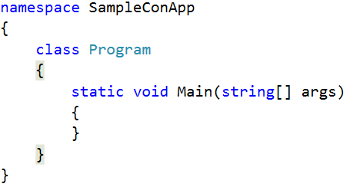
C# Program

Slide 8
Details…..
(M)ain is the entry point of the Program.
Main should be part of the Class and should be static.
Returns integer or nothing.
The Class is recommended to be a part of a Namespace, usually the name of the Project
Optionally can take string array as argument that represents Command line arguments.

Slide 9
Variables
Data Storage structures of C#.
Variables must be initialized before use.
Variables at function level must be explicitly initialized or assigned before being used by the Program.
Variables at class levels are defined to default values automatically.

Slide 10
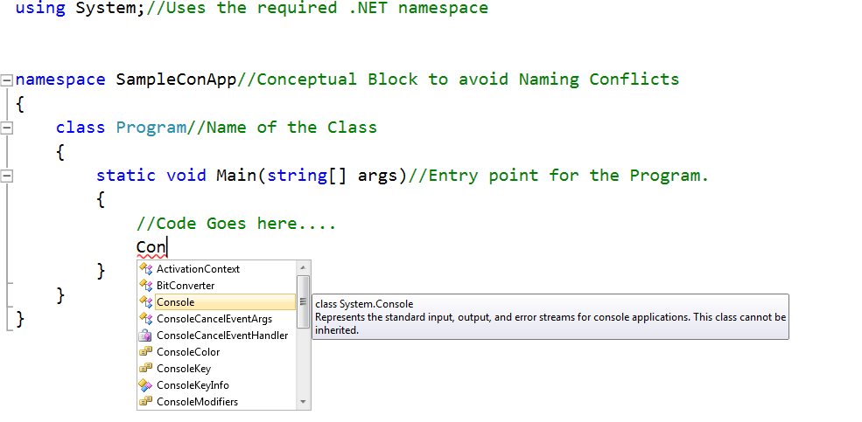
Structure of the Program
Developing Code in Visual Studio 2010 Tool

Slide 11
Main function
Your Program runs from this point.
It is case sensitive.
Optionally it can take only string Array as arguments.
The function should return either integer or nothing(void).
When this function returns, the application exits.
Notes:
Main’s (M) should be caps. This is the syntax that tells symbolically that this is the Main Function

Slide 12
Basic Input/Output
Console class used for Console IO.
Input functions are
Console.ReadLine()
Console.Read()
Console.ReadKey()
Output Functions are:
Console.WriteLine()
Console.Write()
Example
Notes:
ReadLine method reads a stream of text entered by the user on the Console, and returns always a string representation of the text.
Read Method reads a single Character entered and returns the ASCII value of the Character entered.
ReadKey is used to read the Character Key pressed, typically used to End an Application by saying “PRESS ANY KEY TO CONTINUE”
WriteLine writes a stream of content passed as argument on the Console.
It moves the Carrier to the next line.
Write works same as WriteLine but does not move to the next line.

Slide 13
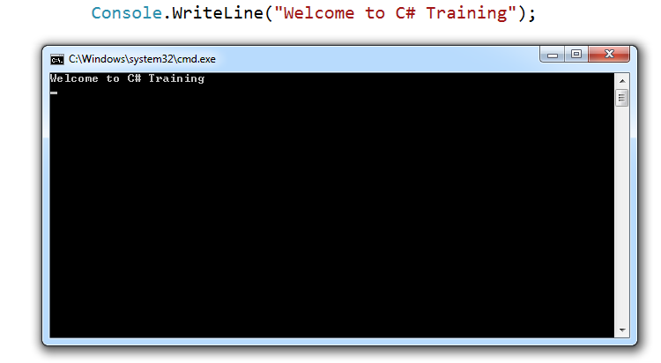
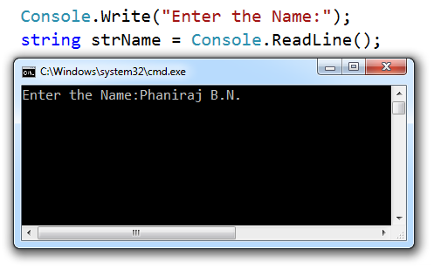
Examples
Make sure to use WriteLine to see what text the User has entered!!!!!

Slide 14











Compilation and Execution
Compilation
Source Code
C#
Compiler
Code (IL)
Assembly
Metadata
Native
Code
JIT Compiler
At installation or the first time each method is called
Execution
Notes:
KEY MESSAGE: Lifetime of a .NET application.
SLIDE BUILDS: 4
SLIDE SCRIPT:
You can author your code in any .NET language. These include the Microsoft languages of C#, C++, VB.NET, J#, etc. In addition, there are a number of 3rd party .NET languages available, including COBOL and Eiffel.
BUILD 1:
Regardless of the language, when you hit the compile button, it isn’t really doing a “compile” in the traditional sense. It’s really more like a translate.
BUILD 2:
The output of a compile is written to an assembly.
BUILD 3:
The assembly doesn’t contain machine code, but another language called Microsoft Intermediate Language (MSIL). You can think of this as .NET’s own platform independent assembly language. This is packaged into a file with a traditional .DLL or .EXE extension, but in .NET speak, this is referred to as “an assembly”.
BUILD 4:
When you execute this code, the framework runs the IL through a Just In Time compiler, which produces native code that is optimized for the platform where the code is executing. The JIT happens once, and the native code is cached for subsequent executions. This makes JIT fundamentally different that a Java VM. The only thing that ever actually executes in the .NET framework is native machine code.
There is also an option to use a utility called NGEN to “pre-JIT” your code so that it doesn’t have to be compiled on execution. However, with NGEN, you loose the ability to have the same IL optimized for the current platform.
SLIDE TRANSISTION: .NET reliability

Slide 15
Data Types
All data types of C# are based on .NET’s Common Type System.
Data Types are represented as keywords.
C# supports Data Types as Value types and Reference types.
Value types are primitive types
Reference types are objects, Arrays, Strings etc.
Structs and Enums are Value Types.
Example.

Slide 16
System.Object
The base class for all the Types in .NET
Functions in this class is available for all the objects of a Program.
Derived classes can override functions like:
Equals: For Equivalence checks.
Finalize: For Clean Up Operations before an object is reclaimed.
ToString: Returns a Human Readable String with Respect to the Instance.
Example.

Slide 17
Flow Controls
Condition Statements:
if else statement
switch statement
Loops Statements
for loop.
foreach loop.
do….while
while loop.
Jump Statements
break; return; continue; goto

Slide 18
Namespace
Define Namespace
namespace namespace_name
{
// code declarations
}
Reference item inside namespace
namespace_name.item_name;
The using keyword
Nested namespace

Slide 19
Using Keyword in Namespace
The using Directive can also be used to create an alias for a namespace.
A namespace definition begins with the keyword namespace followed by the namespace name as follows −
namespace namespace_name { // code declarations }
To call the namespace-enabled version of either function or variable, prepend the namespace name as follows −
namespace_name.item_name;

Slide 20

So how using Namespaces can help?
These namespaces will help me organize classes and reuse them. Fantastic!
Namespace is a Logical collection of classes
Suresh bundles Accounts related class into a namespace Accounts
Discount related classes into Discount
With using keyword he is able to include the namespace
This helps in maintainability and reusability of code

Slide 21
Boxing and UnBoxing
Any Data converted to Object is called BOXING.
Boxing is implicit conversion.
Widely used when creating functions that could be applied on all Types.
Any Data that is boxed needs to be UNBOXED.
UnBoxing is a feature of re-converting an Object back to the Boxed Type.
UnBoxing is Explicit operation where U need to use C Style casting to convert back to the Type from which it was BOXED.
Only BOXED Data could be UNBOXED to the same type.

Slide 22
Control Structures
Transfer of program is based on decision (except for switch)
There are two kinds of control statements
Selection Control Structure
Repetition Control Structure

Slide 23
Selection
the single-selection structure (if)
the double-selection structure (if...else)
the multiple-selection structure (switch)
the inline conditional operator ?:

Slide 24
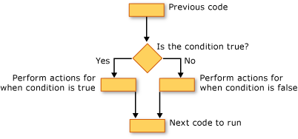
if else

Slide 25
switch
Switch Statement
switch(expression)
{ case constant-expression :
statement(s);
break;
case constant-expression : statement(s);
break;
/* you can have any number of case statements */
default :
statement(s);
}

Slide 26
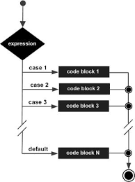
switch

Slide 27


Decide on Decision Making Structures
The mobile company has branded customers into four bands Bronze, Silver, Gold and Platinum.
He has been told that freebies are to be given to them based on their band.
Suresh decides to use a Switch Case for this scenario
This freebie goes to GOLD!

Slide 28
Enums
User Defined named Constants are called Enums.
Represented as Objects of System.Enum Class.
Syntax in C#: ‘enum WeekDays{…..}’ .
Has an underlying Type within, int is default.
Default initial value starts with 0.
Initial Values can be changed thro’ Code.
All Enum values in a Robust Application will be converted to numeric literals.
Use static function Enum.Parse to convert string to the specified Enum Type.

Slide 29
System.Enum
All Enums are derived from System.Enum
Enum.GetValues
Enum.IsDefined
Enum.Parse
Notes:
The above methods are used to process inputs given by the User and validate the Enum values.
GetValues will get all the possible values of the Enum
IsDefined is used to check whether the value belongs to the Enum or not
Parse is used to convert the String value to Enum object.

Slide 30
Best uses of Enums
Enumerations provide sets of constant values that are useful for strongly typing members and improving readability of code.
Do favor using an enumeration instead of static constants.
Use an enumeration to strongly type parameters, properties, and return values that represent sets of values.
Avoid publicly exposing enumerations with only one value.

Slide 31
Arrays
Collection with same data Types
They are self Bound checked, fixed in size.
Arrays are reference Types instantiated with new.
[] operator is used to access elements.
Use for loop to assign values to array with simple iterations.
Use foreach loop to iterate the Array while retrieving data from the Array.
All Arrays are instances of System.Array

Slide 32
Arrays further…
Some Important Properties:
Length
Rank.
Some Important Methods:
GetLength().
GetLowerBound()
GetUpperBound()
Clear
Copy(Static Function).
CreateInstance(Static Function).

Slide 33
Types of Arrays
Single Dimensional Arrays
Multi Dimensional Arrays.
Jagged Arrays:
New in C# which represents Array of Arrays.
Instances of arrays created thro abstract class Array using CreateInstance function.
Demos:
Single Dimensional Array
Multi Dimensional Array
Jagged Array
Array created using CreateInstance.

Slide 34

Loops
while loop
do while loop
for loop
Nested loops
Loop control
break
continue

Slide 35
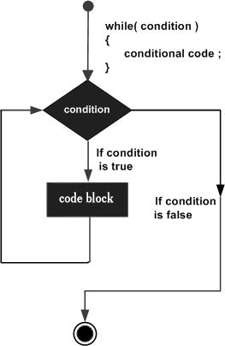
While loop

Slide 36
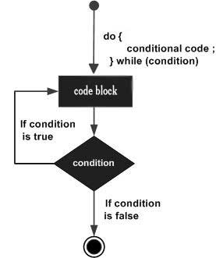
do while loop

Slide 37
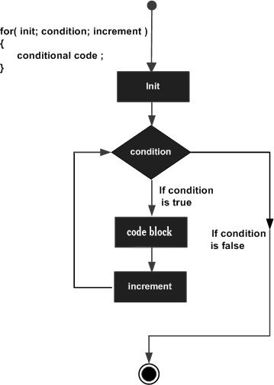
for loop

Slide 38
Nested loops
C# allows to use one loop inside another loop. For example
for ( init; condition; increment )
{
for ( init; condition; increment )
{ statement(s); }
statement(s);
}

Slide 39
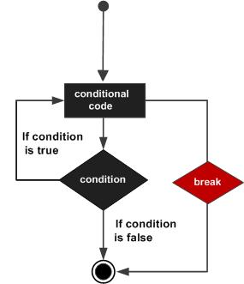
Break statement

Slide 40
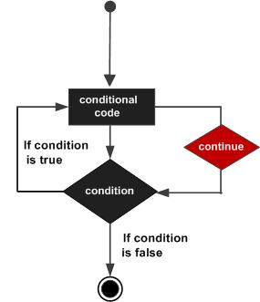
Continue

Slide 41
foreach
Loops applied only on collections.
A simple, clean way to iterate through the elements of an array.
foreach is forward only and read only.
foreach is faster than other iteration Statements.
Foreach internally uses the IEnumerable interface to get the IEnumerator for a Current object and moving next.
Example.

Slide 42
What’s a Class?
Fundamental unit of OOP.
User Defined Reference type.
Combines both behavior and functionality.
An object is required to access the functions.
Variable is to Data Type and object is to Class.
Declared with keyword ‘class’

Slide 43

Class
Class is a blueprint for a data type
Objects are instances of the class
Methods and variables are called the members of the class
Class has a default constructor and destructor

Slide 44

Class
The default access specifier for a class is internal
The default access specifier for the members is private

Slide 45
Class Syntax
<access specifier> class class_name {
// member variables
<access specifier> <data type> variable1;
<access specifier> <data type> variable2;
...
// member methods
<access specifier> <return type> method1(parameter_list)
{
// method body
}
…
}

Slide 46

Properties
Property is a member variable that provides access to private members of the field
Properties are called accessors

Slide 47

Constructor
Constructor is executed whenever a new object is created
Constructor has the same name as class and does not have a return type.
Default constructor has no parameters
We can parameterize the constructor if needed

Slide 48
More on Constructor
Sp. Functions that are invoked before the objects are created.
They are automatically invoked when class is instantiated.
Have Function Signature with name as class’s Name and with an Access specifier.
They will not have any return Type(Not even void).
class TempName
{
public TempName(){……}
}
TempName object=new TempName()
Signature of a Constructor
Instantiation of the Object.

Slide 49
More about Constructors
Parenthesis at the Instantiation of the function is the formal way of Invoking the Constructor.
Constructors can be overloaded.
For every call to the Constructor, base class’s default Constructor is invoked and then the current Object’s Constructor.
You can call the specified Base class Constructor using the Initialization list.
Eg:
public TempClass():base(…)
{
…..
}

Slide 50
Static Constructors
A static constructor is used to initialize any static data, or to perform a particular action that needs to be performed once only.
It is called automatically before the first instance is created or any static members are referenced.
Static Constructors does not have access specifier or have parameters.
It cannot be called directly.
User has no control when the Static Constructor is executed.
Example.

Slide 51

Destructor
Destructor of a class is executed when the object goes out of scope
Destructor will have the exact name as the class prefixed with a tilde (~)
It can neither take in parameters nor can it return value

Slide 52
Methods
Block of statements grouped with an Identifier.
The function performs an action, functionality and returns with some data or nothing(void).
Methods can have arguments passed as Parameters.
Arguments provide a flexibility of invoking methods.
C# does not support optional arguments.

Slide 53
Types of methods
Static Methods:
Defined with static modifier.
Substitute to global functions.
Accessed by the class name. E.g.: ClassName.FunctionName();
Instance Methods
Normal methods.
Needs object thro’ which they are called.
Static methods need objects to invoke instance methods even if they belong to the same class.

Slide 54
Pass by Reference
ref and out.
The ref keyword causes arguments to be passed by reference.
Any changes to the parameter in the method will be reflected in that variable when control passes back to the calling method.
Out is similar to ref except that the caller need not initialize the value when passing it to the function.
The function must assign a value on all conditions before returning to the caller.

Slide 55
params
Params allows functions to be invoked with variable number of arguments.
Params should be the last of the parameter list of a function.
U can have only one params keyword in a method declaration.
Params are always passed by value only.
Example.

Slide 56
Inheritance
Inheritance helps create new classes that
reuse, extend, and modify the base class
The class whose members are inherited is called the base class
The class that inherits is called the derived class
Inheritance is transitive

Slide 57
Inheritance
Inheritance should create an is-a relationship, meaning the child is a more specific version of the parent and is depicted as follows
Animal
Bird

Slide 58
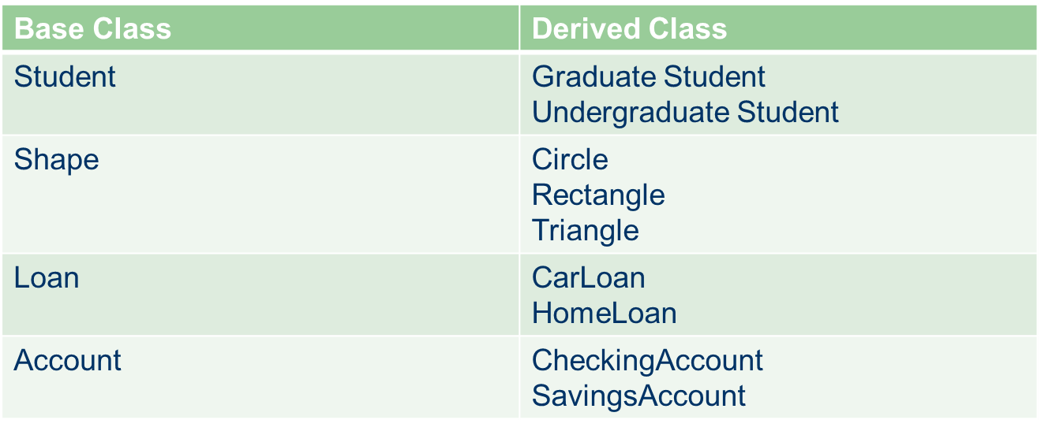
Inheritance

Slide 59
Inheritance
C# supports single inheritance
Private variables are not accessible in the child class
Public and protected variables are accessible in the child class

Slide 60
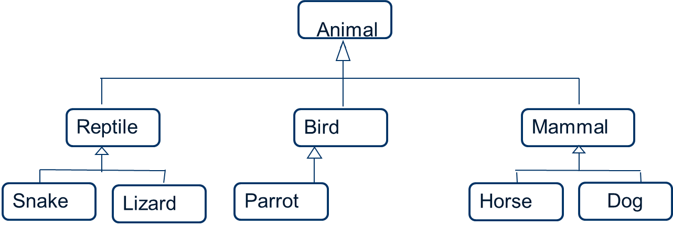
Inheritance – Class Hierarchy

Slide 61
Reference and Inheritance
An object reference can refer to an object of its class, or to an object of any class derived from it by inheritance
For example, if the Holiday class is used to derive a child class called Christmas, then a Holiday reference can be used to point to a Christmas object
Holiday day = new Holiday();
day = new Christmas();

Slide 62
Method Overloading
Functions with Different arguments can have same Name.
This principle is called Function overloading, as the function is (OVER) loaded to perform different multiple tasks at runtime on certain conditions and scenarios, here parameters.
The Runtime appropriately invokes the function based on the arguments passed by the caller.

Slide 63
Rules of Overloading
Same Name for the Functions.
Different Signature:
Number of Parameters.
Order of Parameters.
Data Types of Parameters.
If you want a Late Bound object variable with overload function, you should declare the appropriate parameter as object.

Slide 64
Considerations of Overloading
C# does not support Optional Arguments like VB.
Use Overloading in any one of these scenarios:
The logic in the Function code is significantly different depending on whether the calling code supplies an optional argument or not.
The procedure code cannot reliably test whether the calling code has supplied an optional argument. This is the case, for example, if there is no possible candidate for a default value that the calling code could not be expected to supply.
Major Advantage is the flexibility given to the caller while invoking a Function.

Slide 65
Operator Overloading
Operators could be overloaded in C# to be used on your own classes.
You write a function that has the name operator with the Operator to overload.
All operators to overload should be static.
If U overload == operator, U should also overload the != operator.
The < and > operators, and the <= and >= operators should also be overloaded in pairs.
Use Operator Overloading to serve an actual Purpose, by not misusing it….

Slide 66
Inheritance Features
Single Inheritance.
All classes are in fact inherited from System.object.
C# supports only public inheritance.
Inheritance promotes overriding of methods in derived classes.
U have multi-level inheritance in C#.
Example.

Slide 67
Polymorphism
Polymorphism means many shaped or many forms
Polymorphism can be static or dynamic
Static polymorphism response to a function is determined at compile time
Dynamic Polymorphism the response to a function is decided at run-time

Slide 68
Static Polymorphism
Static polymorphism can be implemented using two techniques
Function Overloading
Operator Overloading
Function overloading allows multiple functions with the same name provided they have a difference in parameters and or return type

Slide 69
Dynamic Polymorphism
Dynamic Polymorphism can be achieved through virtual and override methods
Accessing base class members using the base keyword

Slide 70
Method overriding
Base class can have methods that are intended to be changed by the derived classes.
virtual should be used for such methods.
Makes the function venerable to be changed by the derived classes if they need to do so.
Overriding leads to runtime polymorphism of function invocation.
Example

Slide 71
override keyword
All derived classes who wish to re-implement the base class functions should use override keyword and re-implement them.
Override is applicable for only virtual, abstract and override methods of the base class.
Functions that are overridden would have runtime polymorphism achieved.
Example
Example of runtime polymorphism using object of base class instantiated to derived class.

Slide 72
Method Hiding
If the base class does not provide virtual and the derived class tries to implement the new version, this is called Method Hiding.
Here base method is hidden to the derived object and derived method will be hidden to the base object.
Example.
NOTE:C# gives warning for such methods, so use new keyword as method modifier for such methods, to remove the warnings….

Slide 73
Abstract classes
Need of functions whose implementation is not done.
Abstract Methods.
One or more Abstract methods leads to Abstract classes.
The class is incomplete to create Objects, hence they are not creatable.
Abstract classes can have normal and virtual methods.

Slide 74
How are Abstract Classes used?
Derived classes will and must implement all the abstract methods of the derived class.
They use override to implement the methods.
The object of Abstract classes will be instantiated to the derived class object and the functions are invoked thro’ them.
Derived classes cannot have more than one Abstract class as base class as Multiple Inheritance is not supported in C#.
Solution :Use Interfaces

Slide 75
Concept of Interfaces
If U want to implement more than one Abstract classes, make the Abstract classes as interfaces.
Interface contains only abstract methods.
Like a Contract where I must implement all the functionality.
This feature is basis for many .NET Classes and their implementation features like Collections, Data Components and Remote Architecture.

Slide 76
Interfaces
A sort of skeleton class, containing method signatures but no method implementations.
Have only public members like events, methods, Properties.
Cannot have fields, Constants, Static members, Constructors and Destructors.
Classes can implement more than one interfaces at a time.
Can be implemented implicitly and explicitly.
Example.

Slide 77
Sealed Classes
The sealed modifier prevents other classes from inheriting from it.
It is an error to use the abstract modifier with a sealed class, because an abstract class must be inherited by a class that provides an implementation of the abstract methods or properties.
When applied to a method or property, the sealed modifier must always be used with override.
Because structs are implicitly sealed, they cannot be inherited.
Example.

Slide 78
Collections
A group of objects when can be accessed one at a time with a simple iteration.
They standardize the way a group of objects are handled in the Program.
Fundamental of all collections work on a concept of enumerator.
An object of a Class that implements IEnumerable.

Slide 79
Non Generic Interfaces
ICollection: Foundation on all other Collections that are built.
IDictionary: Collection of key-value pairs.
IEnumerator : Enables contents of a Collection to be obtained one at a time.
IEnumerable : Gets the Enumerator required to iterate.
IComparer : Performs Comparison of objects stored in the collection.
IList : Defines Collection that can be accessed by an indexer.

Slide 80
Non Generic Collection Classes
ArrayList : Provides a basic Dynamic Array.
Queue : Provides a First-In First-Out list.
Stack: A First-In Last-Out List.
HashTable :A Hash Table of key-value pairs.
SortedList: A Sorted List of key-value pairs.
Example.

Slide 81
Generic Collections.
New to C# 2.0 which uses the template concept of C++.
The only difference is the type-safe, optimized Collections without the burden of boxing and unboxing.
ArrayList →List.
HashTable →Dictionary.
U could create UR own generic Collection classes by implementing the Generic Collection Interfaces.

Slide 82
Applying Generics.
Create a Custom Generic Collection class.
Implement the IEnumerable interface.
Create Indexer to access the objects thro an index.
Complete Example of Data Component.
Exercise.

Slide 83
Indexers.
Treating object as an Array.
A Class is an Array of Students.
A Company is a Array of Employees.
Use the object of a Company as an Array and access the Employees using [] operator.
Overloading Subscript operator to access the internal objects of the Array Object is called Indexer.
Implemented like a Property, except the name is ‘this’.

Slide 84
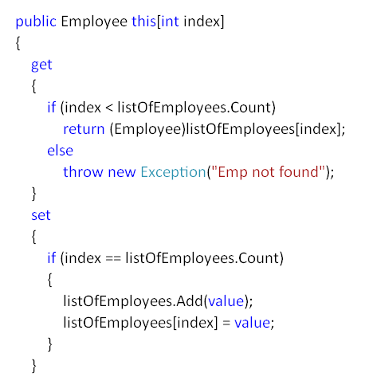
Example.
The indexer would return the Employee object when accessing the object of this class thro an index.

Slide 85
Application of Indexers.
To Access objects of a Collection class using Index.
Create Custom Class with custom Lower bounds an Upper Bounds.
Example of RangeClass.

Slide 86
Exception Handling.
Error occurring at runtime is called Exception.
Automates the large part of Manual Exception handling using Object Oriented Classes.
It enables your program to respond to an error and then continue running.
System.Exception.
System.ApplicationException.
try…catch…finally.

Slide 87
System.Exception
All Exceptions are derived from System.Exception.
Subdivided as SystemException and ApplicationException.
SystemException objects are raised by C# Runtime System(CLR).
All Standard Exceptions are derived from SystemException.
ApplicationException objects are raised by the Applications Programs.
All Custom Exceptions are derived from ApplicationException

Slide 88
Properties of Exception class
Message : Contains a string that describes the nature of the error.
StackTrace : Contains a string that contains the stack of calls that lead to the exception.
TargetSite : Obtains an object that specifies the method that generated the exception.
U could get the class involved in the error by using the ToString().
ToString( ) is automatically called when an exception is displayed via WriteLine( ).

Slide 89
Commonly used Exception
Exception | Meaning
ArrayTypeMismatchException | Type of value being stored is incompatible with the type of the array
DivideByZeroException | Division by zero attempted.
IndexOutOfRangeException | Array index is out of bounds.
InvalidCastException | A runtime cast is invalid.
NullReferenceException | An attempt was made to operate on an object that was not instantiated.
OverflowException | An arithmetic overflow occurred.
StackOverFlowException | By calling Recursive method calls.
OutOfMemoryException | Insufficient free memory exists to continue program execution.

Slide 90
Handling of Exceptions
Functions should handle the exceptions raised by its code in the catch block.
Functions usually throw those raised Exceptions to the caller.
Create a Custom Exception specific to the Application.
Throw the Custom Exception object to the caller function.
Provide Common gateway for all Exceptions raised by the Program.

Slide 91
Important Points
Try must have either a catch or finally block.
U can have multiple catch block for one try block.
Finally block executes on all conditions.
Finally cannot have catch or any form of jump statements.
Finally block executes even after the return Statement.
U cannot have only catch or finally blocks.

Slide 92
Example
Create a Custom Exception class.
Throw the Exception objects in all the Exceptions.
Catch only the Custom Exception at the caller function.
Possibly make entries into ErrorLog file using any trace Listener.

Slide 93
Delegates
A Reference type used to encapsulate a method.
Similar to function pointers of C++
When created, the CLR stores the method pointer in it.
This method will be invoked when the object is triggered.

Slide 94
Delegates
A Delegate is an object referring to a method.
U can invoke the method thro the delegate object.
Similar to function pointers of C++.
The method that will be invoked by a delegate is not determined at compile time, but rather at runtime.
Example of Delegate.
C# 2.o supports method group conversion which means simply assign the name of the method to the object without the new keyword.
Notes:
The idea of a reference to a method may seem strange at first because usually we think of references as referring to objects, but in reality there is little difference. As explained earlier in this book, a reference is essentially a memory address. Thus, a reference to an object is, essentially, the address of the object. Even though a method is not an object, it too has a physical location in memory, and the address of its entry point is the address called when the method is invoked. This address can be assigned to a delegate. Once a delegate refers to a method, the method can be called through that delegate.
If you are familiar with C/C++, then it will help to know that a delegate in C# is similar to a function pointer in C/C++.

Slide 95
Multi casting delegates
One delegate object could reference multiple functions at a time.
Use the += operator to make a multicast delegate object.
One call will invoke all the functions at a time.
This mechanism is also called as delegate chains. It makes set of methods as one Unit.

Slide 96
Anonymous Methods
U some times don’t need an explicit function to be passed to a delegate.
This is called Anonymous method.
Essentially its a block of code that is passed to a delegate.
In many cases, there is no need to actually declare a separate method whose only purpose is to be passed to a delegate.
Example.
Anonymous methods can also have arguments to be passed.

Slide 97
Covariance and Contravariance
Covariance and Contravariance relax the rule of method signature to be same as delegates as it pertains to derived types.
Covariance enables a method to be assigned to a delegate when the method’s return type is a class derived from the class specified by the return type of the delegate.
Contravariance enables a method to be assigned to a delegate when a method’s parameter type is a base class of the class specified by the delegate’s declaration.

Slide 98
Events
An automatic notification that some action has occurred.
An object that has an interest in an event registers an event handler for that event.
When the event occurs, all registered handlers are called. Event handlers are represented by delegates.
Events Example.

Slide 99
Some important points on Events
Events can be specified in interfaces. Implementing classes must supply the event.
Events can be specified as abstract. A derived class must implement the event. Accessor-based events cannot, however, be abstract.
An event can be specified as sealed.
An event can be virtual, which means that it can be overridden in a derived class.

Slide 100
Asynchronous Programming
Function invoked and execution happens without waiting for the function to return to the caller.
Every Delegate has functions called BeginInvoke and EndInvoke to provide Asynchronous Programming.
BeginInvoke is used to invoke a function in an Asynchronous Manner.
EndInvoke makes the caller function wait for the function ending and obtain any result out of it.

Slide 101
BeginInvoke
Initiates the asynchronous call.
Has the same parameters as the method you want to execute asynchronously, plus two additional optional parameters.
The first parameter is an AsyncCallback delegate that references a method to be called when the asynchronous call completes.
The second parameter is a user-defined object that passes information into the callback method.
BeginInvoke returns an IAsyncResult, which can be used to monitor the progress of the asynchronous call.

Slide 102
EndInvoke
The EndInvoke method retrieves the results of the asynchronous call.
It can be called any time after BeginInvoke.
If the asynchronous call has not completed, EndInvoke blocks the calling thread until it completes.
The parameters of EndInvoke include the out and ref parameters of the method you want to execute asynchronously, plus the IAsyncResult returned by BeginInvoke.
Always call EndInvoke to complete the Async call.

Slide 103
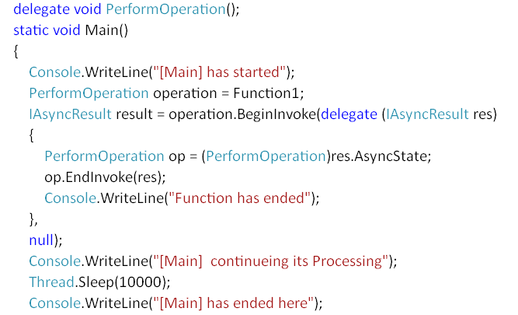
Example
Here PerformOperation is the delegate whose instance is doing BeginInvoke. Note the callback functionality provided…

Slide 104
Serialization
Process of persisting data to storage device.
Process of converting an object into a stream of bytes in order to persist it to memory, a database, or a file.
Its main purpose is to save the state of an object in order to be able to recreate it when needed.
The reverse process is called deserialization.
Advantages include:
Sending objects across remote Application like web services.
Passing object from one Domain to another.

Slide 105
Requirements of Serialization
Data or objects of a class which has attribute Serializable.
Format of Serialization : Binary, XML or SOAP.
Stream : Representing a file, Storage Point.

Slide 106
Formats of Serialization
BinaryFormatter :
Binary serialization uses binary encoding to produce compact serialization for uses such as storage or socket-based network streams.
It is not suitable for passing data through a firewall but provides better performance when storing data.
XML Serialization :
Serializes only the public fields and properties of an object, or the parameters and return values of methods, into an XML stream.

Slide 107
Formats of Serialization
SOAP Serialization:
XML format based on SOAP specification used for transferring data between XML Web services.

Slide 108
Making an object Serializable
Use Serializable attribute for the class whose objects are to be serialized.
SerializationException is thrown if not marked Serializable.
If the derived class is to be made serializable, its base class should also be marked Serializable.
Use NonSerializable attribute for fields whose data U don’t want to save or serialize.

Slide 109
Example
Create a Class marked Serializable.
Use the namespaces required for the Serialization formatters.
Create objects for Streaming data.
Create a Stream object to store the data.
Create the formatter object to serialize.
Use the formatter object to Deserialize the object back from the stream.
Complete Example.

Slide 110
Notes for XML Serialization
Serializable attribute is not required.
Only public members are serialized.
Properties with setters only are serialized.
XML data could be validated to a XML Schema.
System.Xml.Serialization namespace.
XmlSerializer class.

Slide 111
Generics
Template like concept new to C# 2.0.
Generic classes and methods combine reusability, type safety and efficiency
Has a new list of pre built Collection data structures to present Type safe collection Components.
They provide Language Independent usage of Generics.
Create Constraints for Generics.
System.Collections.Generic Namespace.

Slide 112
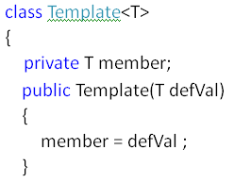
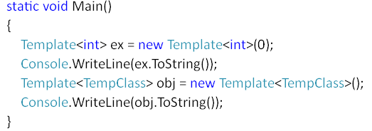
Custom Generic Classes
T is a Generic Type that could be used.
Here we are creating a Constructor to pass a default value to the type so that we could use reflection to identify the object.
Below is the case of creating and using a Template object.
Use default to set default values to reference types

Slide 113
Constraints
You can require that a certain base class be present in a type argument by using a base class constraint. This constraint is specified by naming the desired base class.
You can require that one or more interfaces be implemented by a type argument by using an interface constraint. This constraint is specified by naming the desired interface.
You can require that the type argument supply a parameter less constructor. This is called a constructor constraint. It is specified by new( ).

Slide 114
Constraints
You can specify that a type argument must be a reference type by specifying the reference type constraint: class.
You can specify that the type argument be a value type by specifying the value type constraint: struct.

Slide 115
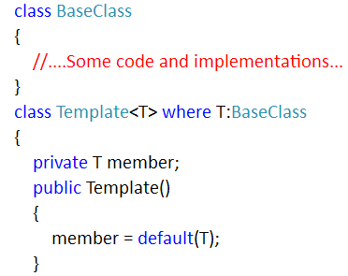
Base Class Constraint

Slide 116
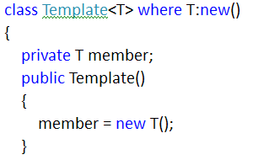
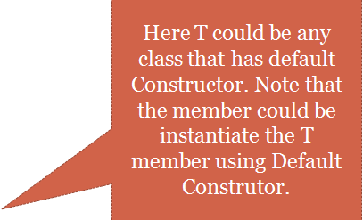
Using new operator

Slide 117
Constraints on Type
The Reference Type and Value Type Constraints
For Class level use Reference Type
For Structs use Value Type.
where T:Class
where T:struct

Slide 118
Assemblies
Deployment unit of .NET Applications.
Can be either EXEs or DLLs.
Assemblies have IL Code and MetaData.
MSIL is a Language of its own that contains the byte level code of the program U have written and Compiled.
Metadata or Manifest contains the data about the IL Code like its Dependencies and other information.
Private Assemblies and Shared Assemblies.

Slide 119
Private Assemblies
Refers to the DLLs created in the Solution.
Use Class Library Project type.
All User defined types should be public.
They will not have entry point and they cannot be executed.
By default, all DLLs U create a Private Assembly.

Slide 120
Private Assemblies
U Reference the DLL in an Executable where U will be using the classes and its methods.
Every reference of this DLL will create a local Copy in the Client’s Directory.

Slide 121
Shared Assemblies
You share assemblies when you want to use an assembly with multiple applications and when versioning is important.
To share an assembly, you must create a shared name—also known as a strong name—for the assembly by using the Strong Name tool in the .NET SDK.
Strong names using the public-private key cryptography to ensure the security of the DLL.

Slide 122
Four main reasons for using a strong name:
It’s the mechanism in .NET for generating a globally unique name.
Because the generated key pair includes a signature, you can tell whether an assembly has been tampered with after its original creation.
Strong names guarantee that a third party can’t release a subsequent version of an assembly you’ve built.
When .NET loads an assembly, the runtime can verify that the assembly came from the publisher that the caller is expecting.

Slide 123
Global Assembly Cache
Found in C:Windows/Assembly.
Data store for components shared by multiple .NET applications.
Assemblies that are installed into the cache by using the Global Assembly Cache tool are stored in the global portion of the cache and are accessible by all applications on the machine.
gacutil –i AssemblyDll.dll
Only Strong named Dlls can be installed in GAC

Slide 124
Integrity with Strong Names
The compiler writes the public key to the manifest, creates a hash of all files that belong to the assembly, and signs the hash with the private key, which is not stored within the assembly.
During development, the client assembly must reference the shared assembly where the compiler writes the public key of the referenced assembly to the manifest of the client assembly.
At runtime, during loading of the shared assembly ,the hash of the shared component assembly can be verified by using the public key stored inside the client assembly.

Slide 125
Integrity of the Strong Name
Only the owner of the private key can change the shared component assembly. There is no way a component Math that was created by vendor A and referenced from a client can be replaced by a component from a hacker. Only the owner of the private key can replace the shared component with a new version.
Integrity is guaranteed in so far as the shared assembly comes from the expected publisher.

Slide 126
Delay Signing of Assemblies
The private key of a company should be safely stored. Most companies don't give all developers access to the private key; only a few security people have it.
That's why the signature of an assembly can be added at a later date, such as before distribution.
When the global assembly attribute AssemblyDelaySign is set to true, no signature is stored in the assembly, but enough free space is reserved so that it can be added later.
However, without using a key, you cannot test the assembly and install it in the global assembly cache; but you can use a temporary key for testing purposes
Later replace this key with the real company key later.

Slide 127
Versioning Issues
Assemblies have a four-part version number as <Major>.<Minor>.<Build>.<Revision>.
The .NET Framework Configuration tool can create application and machine configuration files, which is an MMC Snap-in. You can start this tool from the Administrative Tools in the Control Panel.
Using Binding Policy to bind to the New version of the Assembly to be used.
Note the changed in the App.config file about the new version created.

Slide 128
Publishers Policy
Using assemblies shared in the global assembly cache allows you to use publisher policies to override versioning issues.
Maybe you don't know all the applications that use this shared assembly, but you want to get the bug fix to all of them. In that case, you can create publisher policy files to redirect all applications to the new version of the shared assembly.

Slide 129
Steps of creating a Policy file
To set up publisher policies, you have to do the following:
Create a publisher policy file.
Create a publisher policy assembly.
Add the publisher policy assembly to the global assembly cache.
Use the naming convention for the new policy file to work.
Some Applications can override the Publishers Policy.

Slide 130
ADO.NET
Provides a consistent way to access datasources
Datasources could be exposed through OLEDB or ODBC
The ADO.NET classes can be found in the System.Data namespace

Slide 131
ADO.NET Objects
ADO.NET Objects provided are
Connection Object
Command Object
DataReader
DataAdapter
DataSet

Slide 132
Dataset and Data tables
DataSet is a disconnected database
It contains one or more Data tables
The DataTable can have row, column, primary and foreign key constraint

Slide 133
Datareader Vs Dataset
Dataset is used
To cache data locally in your application
Pass Data between tiers of the application
Extensive processing on Data
Dynamically interact with data like binding it to a control

Slide 134
Datareader Vs Dataset
DataReader is used to only read results of the query
By using only DataReader performance can be boosted

Slide 135
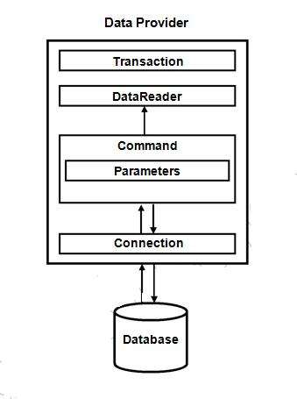
ADO.NET Connected Architecture

Slide 136
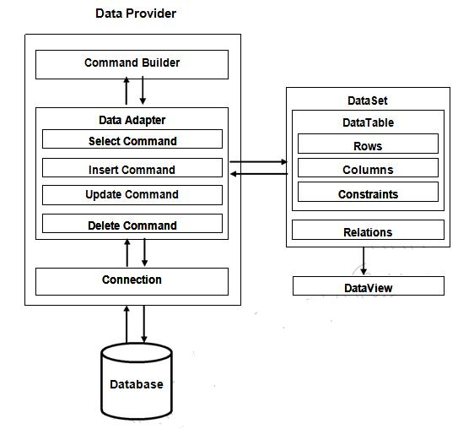
ADO.NET Disconnected Architecture

